Slide 1

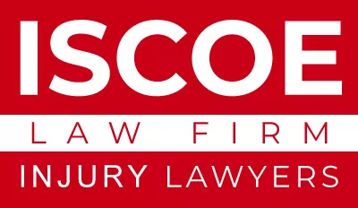
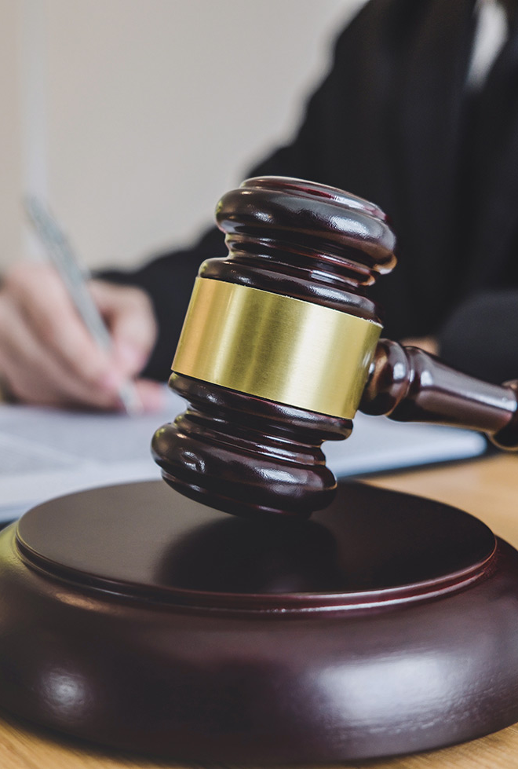

About Us
We Are the Iscoe Law firm, Tell Us Your Story And We Will Find A Way To Make It Right For You.
Since 1991, Attorney GARY T. ISCOE has been dedicated to holding the powerful accountable for taking advantage of the powerless. From representing clients in serious injury cases, wrongful death cases, class actions, and other lawsuits including medical malpractice, product liability, and more, Gary and his team of attorneys get YOU justice.

Slide 2
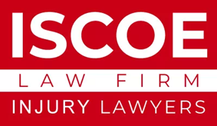

Since 1991, Attorney GARY T. ISCOE has been dedicated to holding the powerful accountable for taking advantage of the powerless.
699+
1280+
92%
Happy Clients
Case Trial
Success Case
From representing clients in serious injury cases, wrongful death cases, class actions, and other lawsuits including medical malpractice, product liability, and more, Gary and his team of attorneys get YOU justice. At Iscoe Law Firm, our Florida personal injury attorney team helps people – men and women just like you – fight against insurance companies and other liable parties.
After an injury or the death of a loved one, you have rights, and it’s our job to help you exercise those rights. We stand with you, investigating the accident, documenting the seriousness of your injuries, consulting with experts, and advocating on your behalf to eliminate your stress so you can focus on healing. We build strong cases and see them through to settlement or trial to ensure you get fair compensation for the injuries that impact your life.

Slide 3

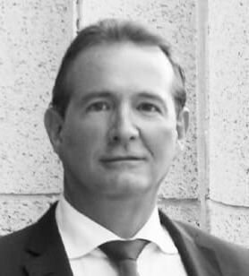
“I pride myself on getting my clients back to their daily lives with the necessary compensation to do so.”
Gary T. Iscoe
Esquire & Founding Partner

Slide 4
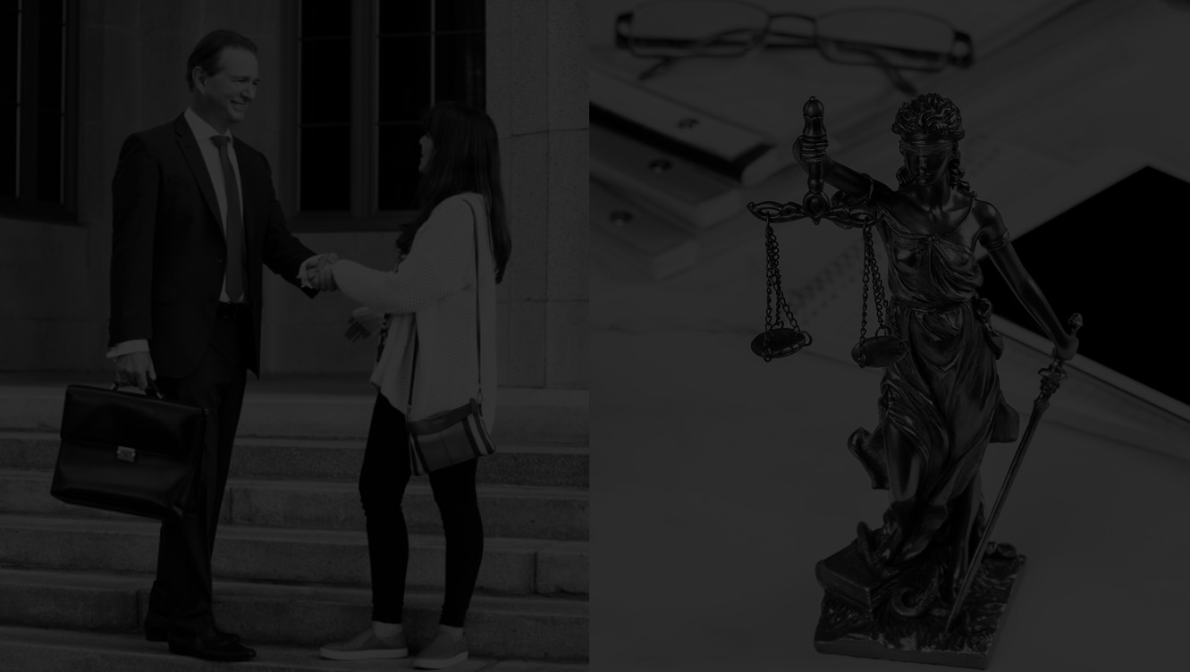



Testimonials
What Our Recent Clients Say About the Iscoe Law firm
Jalina H.
Robin D.
Shyla M.
Businessman
Gary Iscoe is more than a top notch Personal Injury attorney. He is an icon in our community. He has been making sure all of our friends, neighbors, and family have been properly compensated for injuries and damages to make them whole again.
I worked at a chiropractor office that delt with mainly injury cases. Iscoe was one of the law firms we worked with and I must say he is very kind, understanding and is always willing to help you get you what you need. You will not be disappointed…
Clearly knowledge and helped me out with my issue. Truly an amazing attorney. Would definitely use again if needed.
READ MORE
READ MORE
READ MORE

Slide 5
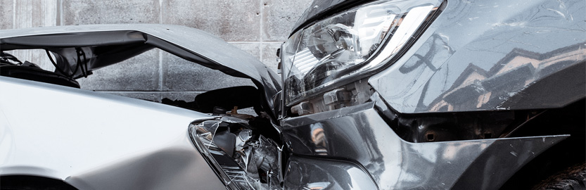
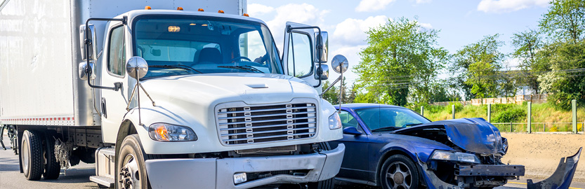
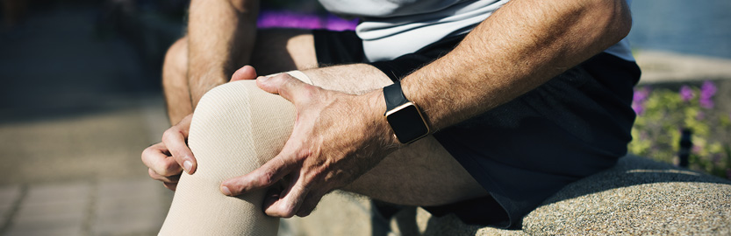
Car accident claims are about money
Most car accidents, fortunately, do not result in hideous life-altering injuries. Ultimately, then, what they care about is recovering sufficient money to cover the losses caused by the accident.
CAR ACCIDENTS
Truck accidents are not the same as car accidents
They usually result in different kinds of accidents, and they typically cause different types of injuries. Victims should consult experienced counsel before making any decisions or settlements in a truck accident case.
TRUCK ACCIDENTS
What is a personal injury accident?
A personal injury accident is any accidental injury suffered by an individual and caused by the negligence or recklessness of another.
PERSONAL INJURY

